Slide 1

SIMONS FOUNDATION 160 Fifth Avenue New York, NY 10010
Tensor train algorithms for quantum dynamics simulations of excited state nonadiabatic processes and quantum control
Victor S. Batista
Yale University, Department of Chemistry &
Energy Sciences Institute
NSF
DOE
NIH
AFOSR

Slide 2



The TT-SOFT Method Multidimensional Nonadiabatic Quantum Dynamics
Samuel Greene and Victor S. Batista
Department of Chemistry, Yale University
Samuel Greene

Slide 3
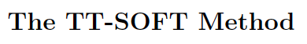
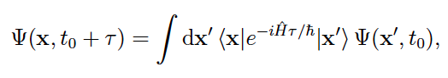
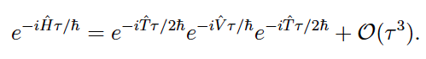
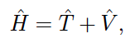
SOFT Propagation

Slide 4
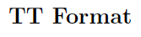
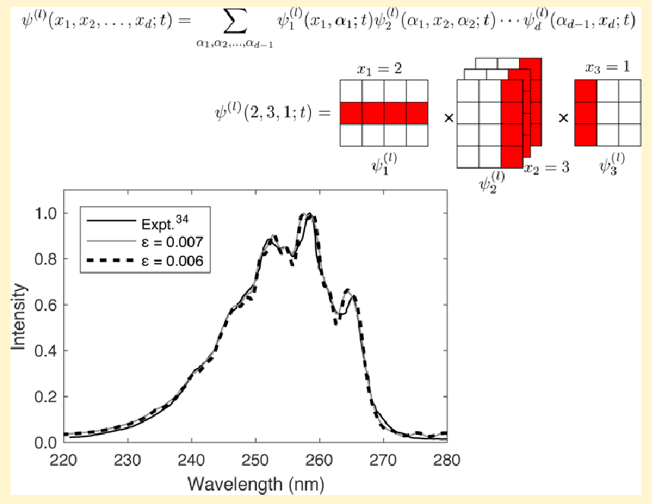

Slide 5
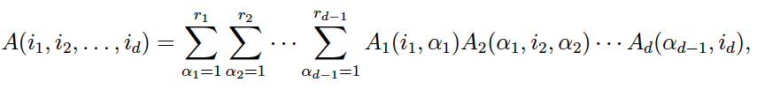
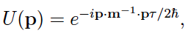
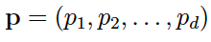
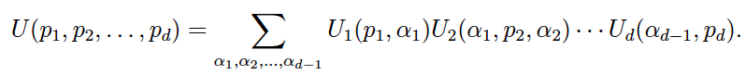
Generic Tensor
Wavepacket
Kinetic Propagator

Slide 6
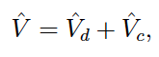
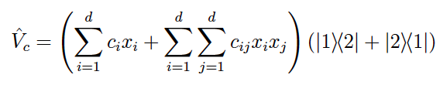
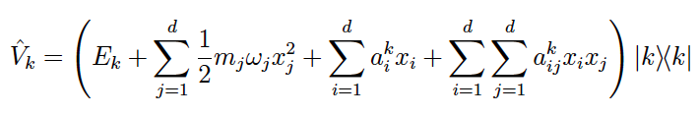

Slide 7
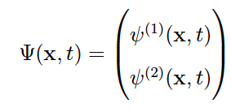
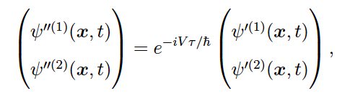
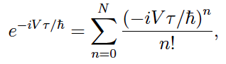
25-Dimensional S₁/S₂ Wavepacket Components

Slide 8
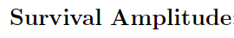
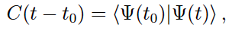
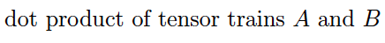
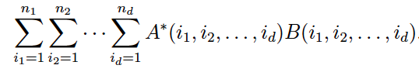
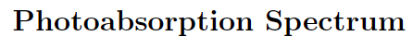
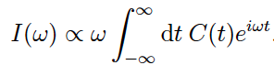
Tensor-Train Split-Operator Fourier Transform (TT-SOFT) Method: Multidimensional Nonadiabatic Quantum Dynamics
Samuel M. Greene and Victor S. Batista
J. Chem. Theory Comput. 2017, 13, 4034−4042

Slide 9
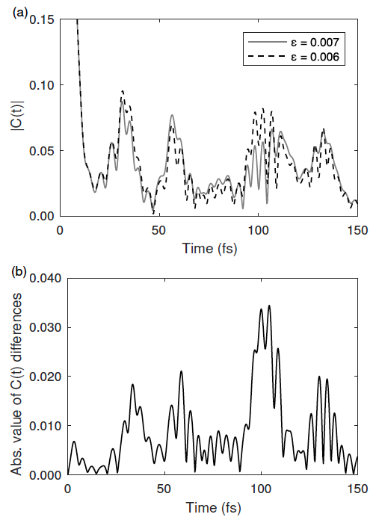
Tensor-Train Split-Operator Fourier Transform (TT-SOFT) Method: Multidimensional Nonadiabatic Quantum Dynamics
Samuel M. Greene and Victor S. Batista
J. Chem. Theory Comput. 2017, 13, 4034−4042

Slide 10
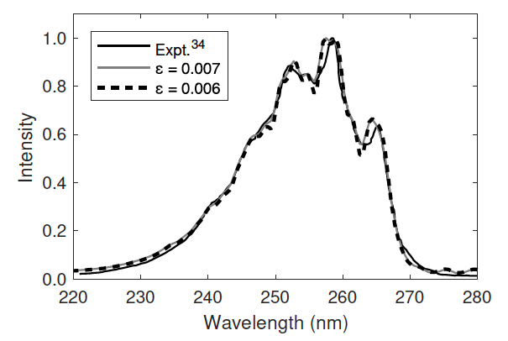
Tensor-Train Split-Operator Fourier Transform (TT-SOFT) Method: Multidimensional Nonadiabatic Quantum Dynamics
Samuel M. Greene and Victor S. Batista
J. Chem. Theory Comput. 2017, 13, 4034−4042
Comparison TT-SOFT versus Experimental Spectra of Pyrazine

Slide 11
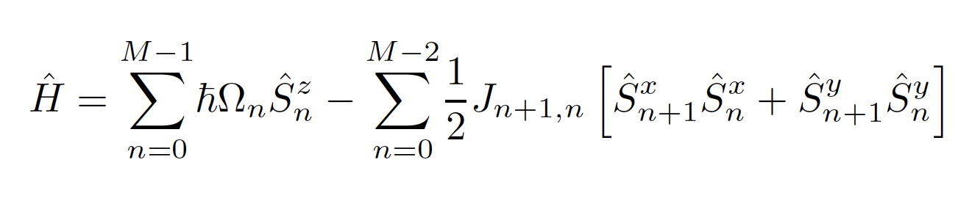
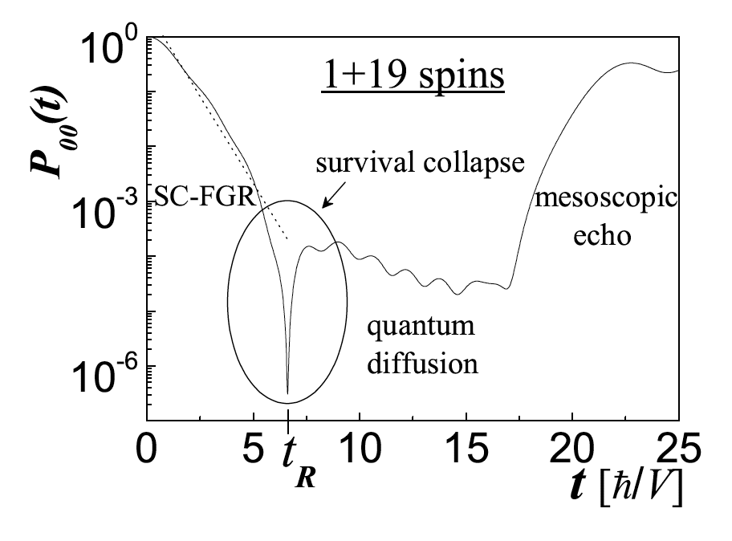
Tensor-Train Split-Operator Fourier Transform (TT-SOFT) Method
E. Rufeil Fiori, H.M. Pastawski Chem. Phys. Lett. 420: 35-41

Slide 12
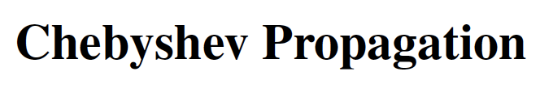
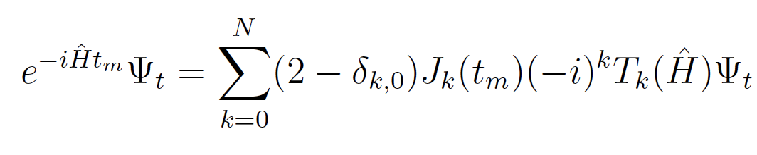
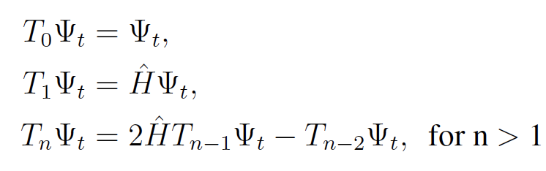

Slide 13
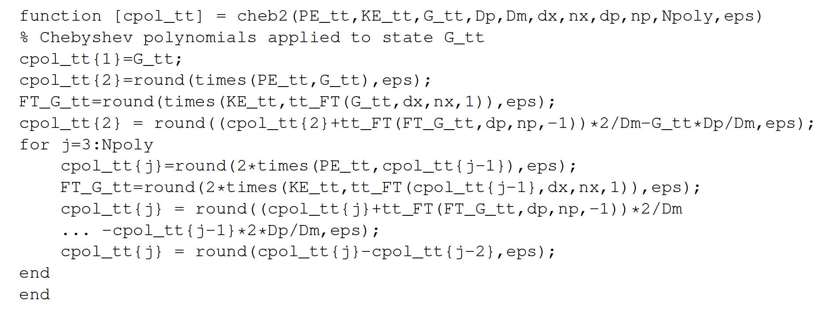
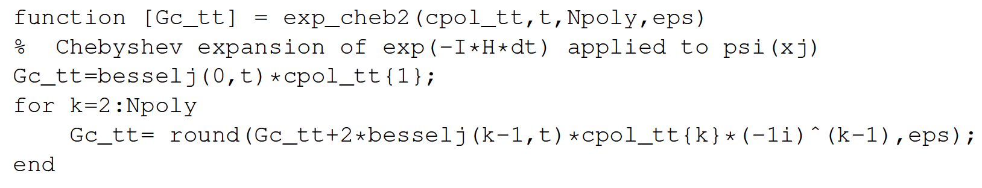

Slide 14
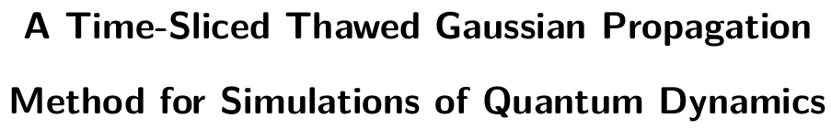



Slide 15
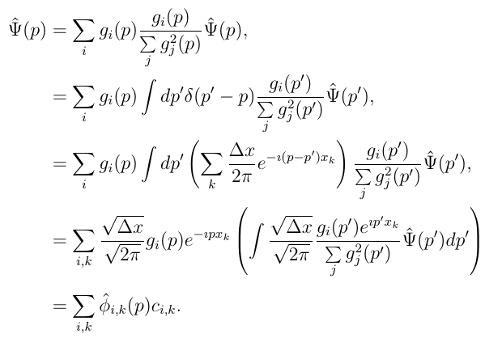
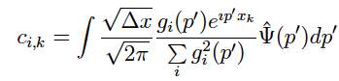
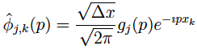
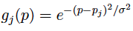
=1
FGWT
Qian, J.; Ying, L. Fast Gaussian Wavepacket Transforms and Gaussian Beams for the Schrödinger Equation. J. Comp. Phys. (2010) 229: 7848–7873.
Kong, X.; Markmann, A.; Batista, V.S., A Time-Sliced Thawed Gaussian Propagation Method for Simulations of Quantum Dynamics. J. Phys. Chem. A 120: 3260-3269(2016).

Slide 16
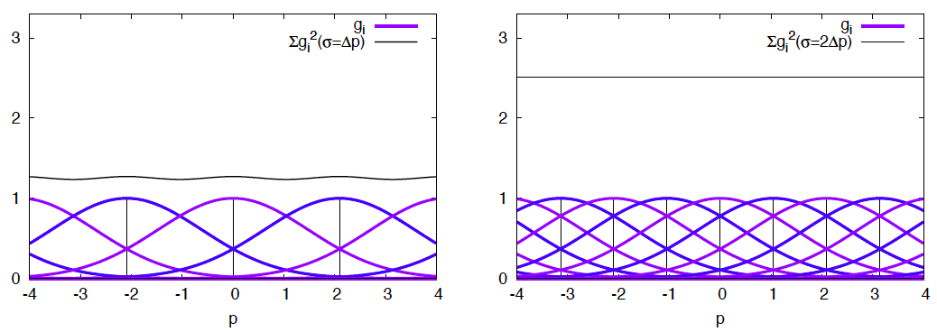
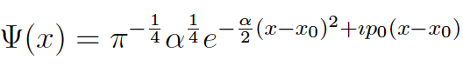
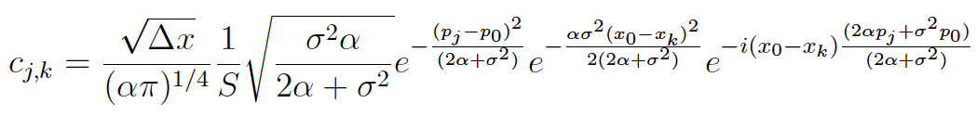
Time Sliced Thawed Gaussian Propagation Method
Kong, X.; Markmann, A.; Batista, V.S., A Time-Sliced Thawed Gaussian Propagation Method for Simulations of Quantum Dynamics. J. Phys. Chem. A 120: 3260-3269(2016).
FGWT
HT

Slide 17
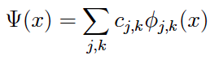
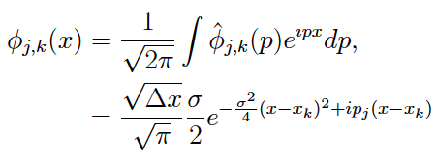
Time Sliced Thawed Gaussian Propagation Method
Kong, X.; Markmann, A.; Batista, V.S., A Time-Sliced Thawed Gaussian Propagation Method for Simulations of Quantum Dynamics. J. Phys. Chem. A 120: 3260-3269(2016).

Slide 18
Heller, E. J. Time-Dependent Approach to Semiclassical Dynamics. J. Chem. Phys. (1975) 62: 1544–1555.

Slide 19
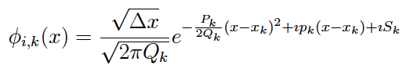
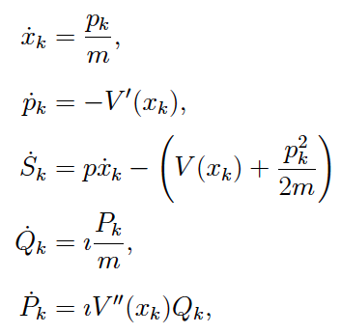
Gaussian Beam Thawed Gaussian Propagation
Hermite Gaussian Basis
Hagedorn, G. A.: Raising and lowering operators for semiclassical wave packets. Ann. Phys. 269: 77-104 (1998)] and [Faou, E.,Gradinaru, V.; Lubich, C: Computing Semiclassical Quantum Dynamics with Hagedorn Wavepackets. SIAM J. Sci. Comput. 31: 3027-3041 (2009)]:

Slide 20
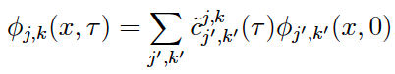
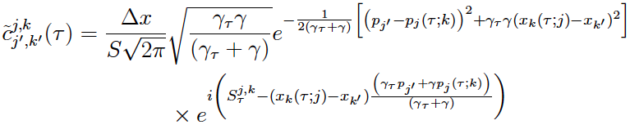
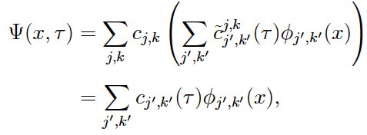
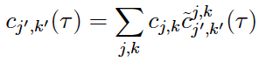
Time Sliced Thawed Gaussian Propagation Method
Kong, X.; Markmann, A.; Batista, V.S., A Time-Sliced Thawed Gaussian Propagation Method for Simulations of Quantum Dynamics. J. Phys. Chem. A 120: 3260-3269(2016).
Lagrangian propagation
HT
Eulerian propagation

Slide 21
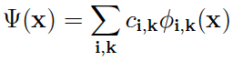
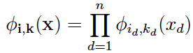
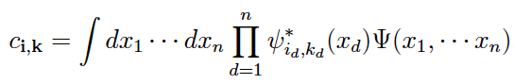


Time Sliced Thawed Gaussian Propagation Method
n-dimensional implementation
Kong, X.; Markmann, A.; Batista, V.S., A Time-Sliced Thawed Gaussian Propagation Method for Simulations of Quantum Dynamics. J. Phys. Chem. A 120: 3260-3269(2016).

Slide 22

Time Sliced Thawed Gaussian Propagation Method
n-dimensional implementation
Kong, X.; Markmann, A.; Batista, V.S., A Time-Sliced Thawed Gaussian Propagation Method for Simulations of Quantum Dynamics. J. Phys. Chem. A 120: 3260-3269(2016).

Slide 23

Time Sliced Thawed Gaussian Propagation Method
n-dimensional implementation
Kong, X.; Markmann, A.; Batista, V.S., A Time-Sliced Thawed Gaussian Propagation Method for Simulations of Quantum Dynamics. J. Phys. Chem. A 120: 3260-3269(2016).

Slide 24



Time Sliced Thawed Gaussian Propagation Method
n-dimensional propagation
Kong, X.; Markmann, A.; Batista, V.S., A Time-Sliced Thawed Gaussian Propagation Method for Simulations of Quantum Dynamics. J. Phys. Chem. A 120: 3260-3269(2016).

Slide 25



Slide 26



Slide 27


A New Bosonization Technique The Single Boson Representation
Kenneth Jung, Xin Chen and Victor S. Batista
Department of Chemistry, Yale University
Kenneth Jung
Xin Chen

Slide 28










Holstein-Primakoff Representation
Spin-Boson Hamiltonian
[T. Holstein and H. Primakoff Phys. Rev. 58, 1098-1113 (1940)]
Notes:
Angular momentum operators are transformed by harmonic oscillator operators
The commutation relations of the harmonic oscillator operators ensures that the computation relations of the angular momentum operators are satisfied.
The mapping is based on a single boson but, unfortunately, it introduces momenta under a square root very much like the relativistic energy E = sqrt(m^2 c^2 (c^2 + v^2), although the square root would remain even when trying to formulate a Schrodinger-like equation, like the Klein-Gordon equation.

Slide 29

Schwinger-Bosonization
Schwinger-Jordan Transform
[P. Jordan, Z. Phys. 94, 531 (1935)]
[J. Schwinger, in Quantum Theory of Angular Momentum, edited by L. C. Biedenharn and H. V. Dam Academic, New York (1965)]
Notes:
An alternative bosonization technique to transform angular momentum operators by harmonic oscillator operators was introduced by Jordan and Schwinger.
The main difference when compared to the Holstein-Primakoff transformation is that each angular momentum operator is represented by products of operators of pairs of harmonic oscillators

Slide 30

Schwinger-Jordan Representation
Jordan-Schwinger Transform
Constraint:
[P. Jordan, Z. Phys. 94, 531 (1935)]
[J. Schwinger, in Quantum Theory of Angular Momentum, edited by L. C. Biedenharn and H. V. Dam Academic, New York (1965)]
Notes:
As in the HP transformation, the commutation relations relations of the harmonic oscillator operators ensures that the computation relations of the angular momentum operators are fulfilled.
However, the two bosons are constrained by the eigenvalues of S^2.

Slide 31







Schwinger-Jordan Representation
Spin-Boson Hamiltonian
[P. Jordan, Z. Phys. 94, 531 (1935); J. Schwinger, in Quantum Theory of Angular Momentum, edited by L. C. Biedenharn and H. V. Dam Academic, New York (1965)]
Notes:
When implemented for representing the Spin-Boson Hamiltonian (s=1/2), the Schwinger representation gives what in our family we call the Meyer-Miller Hamiltonian, which is essentially the Hamiltonian of two coupled Harmonic oscillators.
The zero-point energy of the oscillators is introduced directly due to the commutation relation between coordinates and momenta. So, modifying that value is equivalent to modifying the commutation relation between x and p.
The constraint, given by the eigenvalue of S^2, imposes an additional constraint on the operators of the harmonic oscillators.

Slide 32


Schwinger-Jordan Representation
N-Level Hamiltonian
[H.-D. Meyer and W. H. Miller J. Chem. Phys. (1979) 70, 3214; M. Thoss and G. Stock Phys. Rev. Lett. 78, 578 (1997); V.S. Batista and W. H. Miller J. Chem. Phys. 108, 498 (1998)]
Notes:
The Schwinger representation of the N-level Hamiltonian for non-equally spaced states requires N-harmonic oscillators.
While the Hamiltonian is exact, as we discussed several times throughout this meeting, the outstanding question is how to implement it efficiently to obtain accurate results. For example, SC-IVR implementations of this Hamiltonian are usually very demanding since they involve high dimensional integrals.

Slide 33







Harmonic Basis Set
Notes:
The basis of

Slide 34




Matrix Representation of Boson Operators

Slide 35





Single Boson Representation of P_{jk}= |j><k| Operators
6-level System: Single Boson Representation

Slide 36

Single Boson Representation of P_{jk}= |j><k| Operators
6-level System: Single Boson Representation

Slide 37

Single Boson Representation of P_{jk}= |j><k| Operators
6-level System: Single Boson Representation
Recurrence Relation:

Slide 38


N-level System: Single Boson Representation
N-level System: Jordan-Schwinger Representation

Slide 39



Two-level Systems: Single Boson Representation

Slide 40

Two-level Systems: Single Boson Representation

Slide 41

Single Boson DVR Hamiltonian
H(x, p=0)
x

Slide 42







Single Boson DVR Hamiltonian

Slide 43


Single Boson DVR Hamiltonian
|Ψ(x)|, Re[Ψ(x)]
P(t)
x
t

Slide 44

Single Boson Representation of Pauli Matrices

Slide 45


Single Boson Representation of Pauli Matrices

Slide 46




Single Boson Representation of Pauli Matrices

Slide 47

Single Boson Representation of Pauli Matrices

